Slide 1
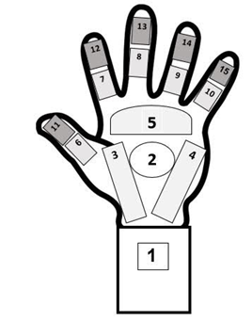
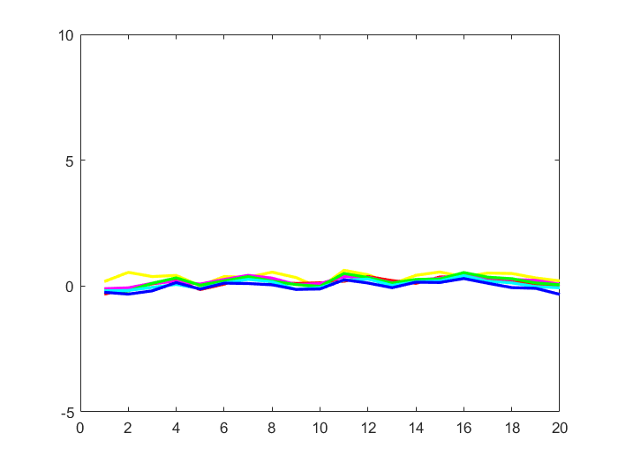
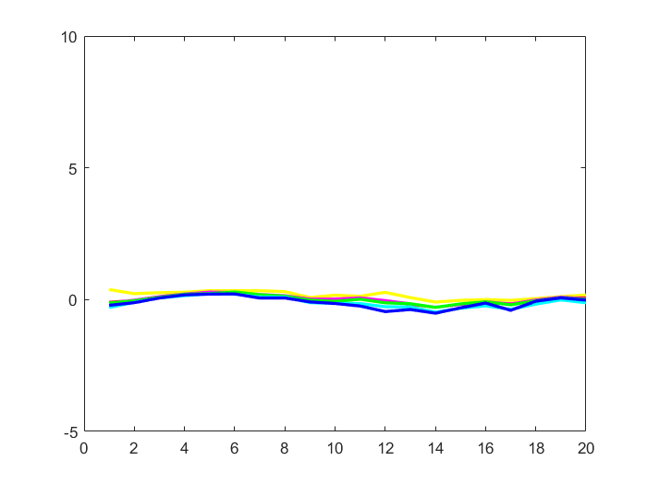
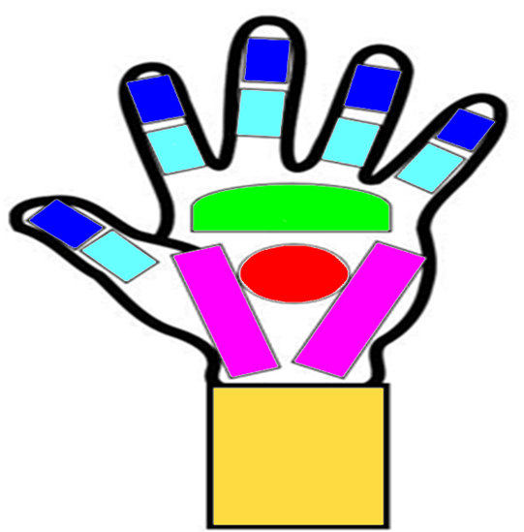
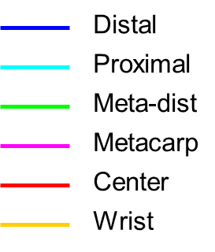
We use the first 6 min. to predict the behavior in each hand part for the remaining 20 min.
Each time the model is built on 19 subjects (for which we learn the 20 min. follow up from the 6 min. illumination)
and we predict for a new subject given his/her first 6 min. behavior.
Here are some plots:
Subject #5:
true
predicted

Slide 2
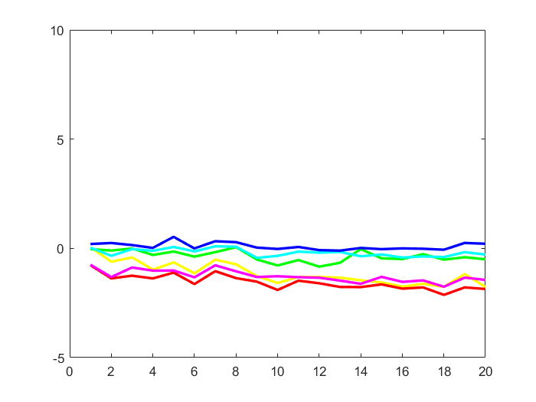
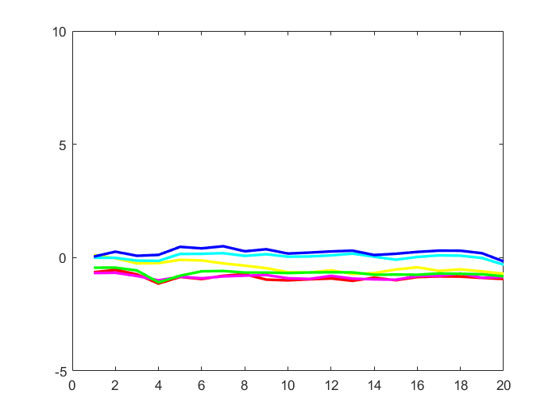
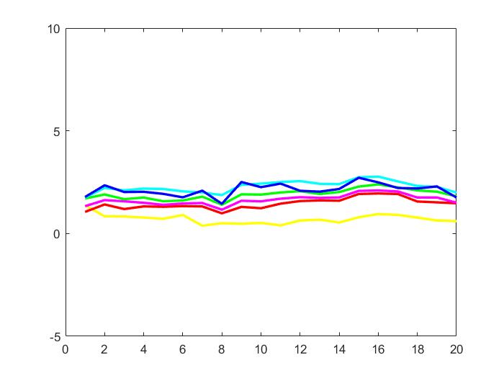
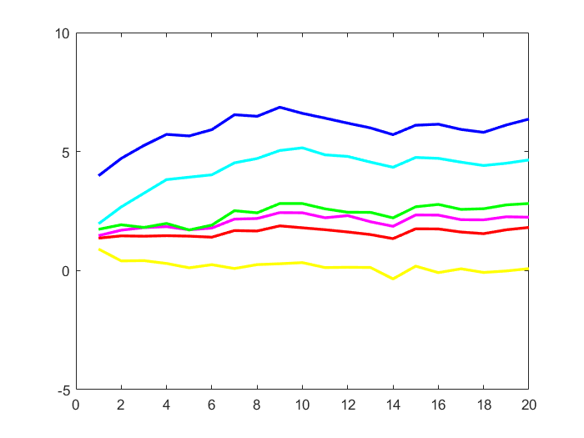
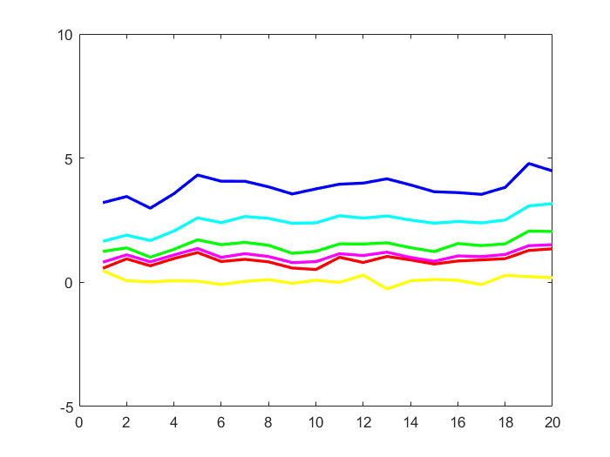
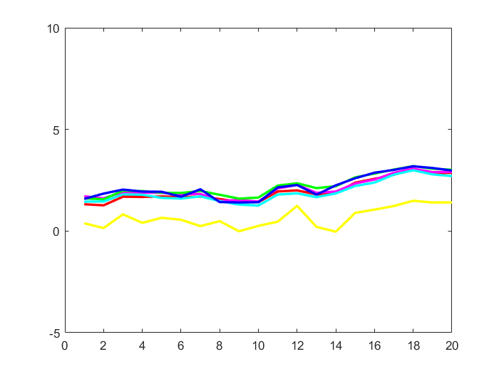
Subject #11:
true
predicted
Subject #18:
true
Subject #17:
true
predicted
predicted

